Slide 1
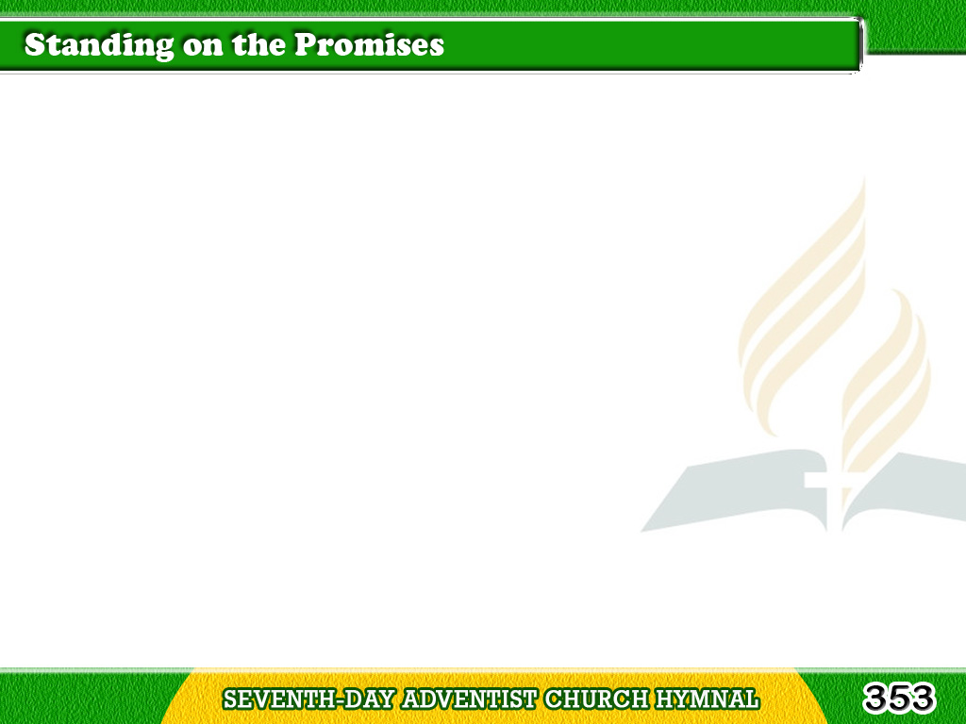
1/3
Standing on the promises
of Christ my King,
Thru eternal ages
let His praises ring;
Tagalog
Version

Slide 2
1/3
Glory in the highest
I will shout and sing,
Standing on the promises of God.
Tagalog
Version

Slide 3
1/3
Chorus
Standing, standing,
Standing on the promises
of God my Savior;
Tagalog
Version

Slide 4
1/3
Chorus
Standing, standing,
I’m standing
on the promises of God.
Tagalog
Version

Slide 5
2/3
Standing on the promises
that cannot fail,
When the howling storms
of doubt and fear assail,
Tagalog
Version

Slide 6
2/3
By the living word of God
I shall prevail,
Standing on the promises of God.
Tagalog
Version

Slide 7
2/3
Chorus
Standing, standing,
Standing on the promises
of God my Savior;
Tagalog
Version

Slide 8
2/3
Chorus
Standing, standing,
I’m standing
on the promises of God.
Tagalog
Version

Slide 9
3/3
Standing on the promises
of Christ the Lord,
Bound to Him eternally
by love’s strong cord,
Tagalog
Version

Slide 10
3/3
Overcoming daily
with the Spirit’s sword,
Standing on the promises of God.
Tagalog
Version

Slide 11
3/3
Chorus
Standing, standing,
Standing on the promises
of God my Savior;
Tagalog
Version

Slide 12
3/3
Chorus
Standing, standing,
I’m standing
on the promises of God.
Tagalog
Version

